Slide 1

Social Cognitive
Theory
Arnoldo Ruiz

Slide 2
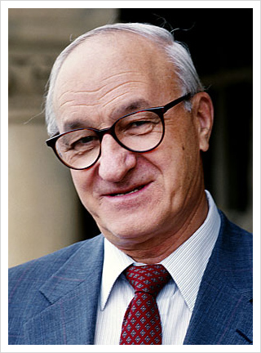

Albert Bandura
(December 4, 1925 – July 26, 2021)
Mundare, Alberta, CAnada
https://albertbandura.com/

Slide 3
Why do humans act the way they do?

Slide 4
Came about right after behaviorism
“In this environment, general social learning theories initially emerged (Bandura & Walters, 1963). These theories focused on imitation and rewarded behaviors. Where behaviorism placed emphasis squarely on internal mental processes (i.e., paired associations), social learning theories moved the focus to environmental cues (Bandura, 1986). However, these general theories of social learning failed to explain why individuals imitated the behaviors of others when the imitator was not directly rewarded for the behavior or why novel behaviors were ever undertaken in the first place.”
(Oliver, 100)

Slide 5
The theory further explained
Social cognitive theory (SCT), in simplest terms, explains how humans can learn and be motivated to perform behaviors by observing others. But this does not mean that humans simply mimic others. SCT is based on an agentic perspective (Bandura, 1986, 2006), meaning that the theory views humans as having agency: We are proactive, self-regulating, self-organizing, and both purposefully and reflexively adaptive to changes in the environment.
(Oliver, 101)

Slide 6
Limitations
“The theory can be applied to almost any media content or technology and can encompass any behavior, including those we might want to encourage and those we would rather discourage… However, this breadth can also be seen as a weakness to the theory. At its core, SCT offers a transactional model for behavior that is based on both cognitive processes and social/environmental inputs. Despite the fact that numerous variables have been identified as being potentially involved in these processes”
(Oliver, 109)

Slide 7
Thank you!

